Slide 1
Voice based Email System for Visually Impaired
Team 12:
Srividya Krishnakumar (55)
CS5A

Slide 2
Roadblocks to ASR
Different people speak at different volume.
Accent
Noise
Sentence phrasing

Slide 3
Overview
Most systems emphasize more on user friendliness of normal users, but not that of all types of people including normal people visually impaired people as well as the illiterate.
The complete system is based on IVR - interactive voice response.
Notes:
IVR - Call center -- connecting --- press 1, 2, ...

Slide 4
The computer prompts the user to perform specific operations.
All operations based on mouse click events.
As particular location cannot be tracked by the blind user, the system has given the user a free will to click blandly anywhere on the screen.
Which type of click will perform what function is specified by the IVR.
Notes:
How will the user know where to click?

Slide 5
Design

Slide 6
UI Design
The user interface is designed using Adobe Dreamweaver CS3.
The complete website focuses more on efficiency in understanding the IVR rather than the look and feel of the system.
Notes:
System primarily developed for the visually impaired, so look is not of utmost importance.

Slide 7
Database Design
A database is maintained for user validation and storing user emails.
There are a total of five tables.
The E-R diagram of our complete system is depicted in Fig 1.
The Inbox, Sent-Mail and Trash schemas will store all mails of the respective service that belongs to that particular user.
Notes:
System primarily developed for the visually impaired, so look is not of utmost importance.

Slide 8
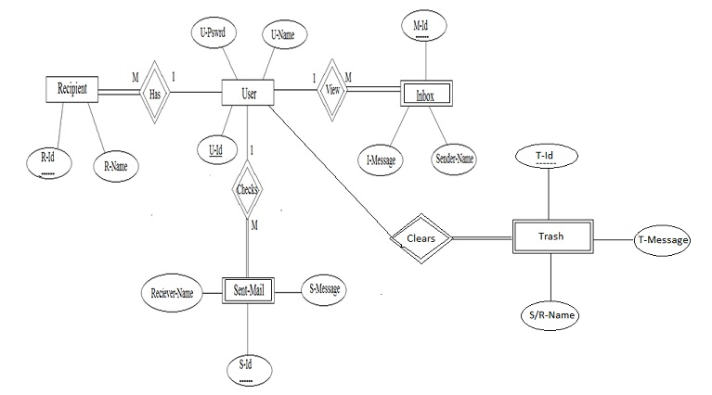

Slide 9
System Design
Fig. 2 depicts the complete system design.
It is the level-2 data flow diagram which gives complete detailed flow of events in the system.
All operations are performed by mouse click events only.
At some places, voice input is required.

Slide 10
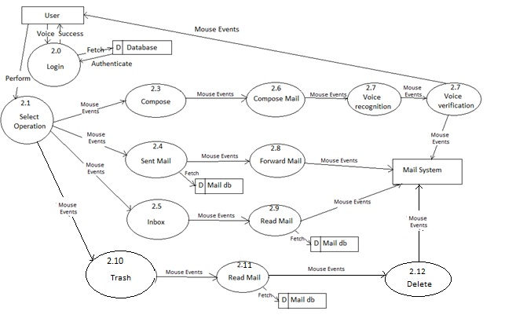

Slide 11
Implementation

Slide 12
User Registration/Login
New users register with username and password.
Necessary information about the user is prompted during registration.
Username and password accepted as speech input, and validated.
An option to reset password if the user forgets password.

Slide 13
Home Page
User redirected to the home page upon successful login.
Options available for the user:
Inbox
Compose
Sent Mail
Trash
Double click is reserved for logout.
The mouse click operation that needs to be performed is prompted by the IVR.

Slide 14
Compose Email
User records a message that needs to be sent.
The voice message goes in the form of an attachment.
Once the message is recorded, the user hears an audio playback to verify the recording.
The message is then sent to the intended recipient.
The receiver downloads the attachment and plays the audio message.

Slide 15
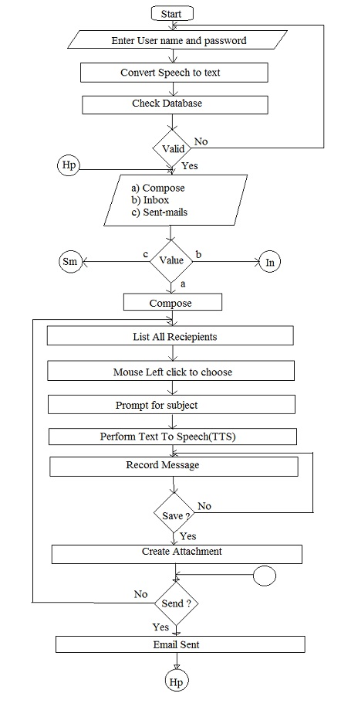
Notes:
In - Inbox
Hp - Home Page
Sm - Sent Mail

Slide 16
Inbox
To view all the emails received by the user.
The user can listen to mails he/she wants to by performing the click operation specified by the prompt.
In order to navigate through different mails prompt will specify which operations to perform.
Each time a mail is selected, the user will be informed about its sender and the subject.
User can decide whether the mail needs to be read or not, or whether it should be deleted.
Deleted mails are saved in Trash.

Slide 17
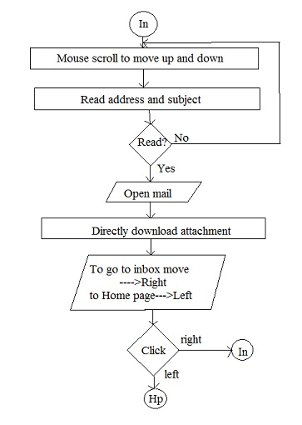
Notes:
In - Inbox
Hp - Home Page
Sm - Sent Mail

Slide 18
Sent Mails
Keeps track of the mails sent by the user.
In order to access the sent mails user will need to perform the actions provided by the prompt.
When the control lands on particular mail, the user is prompted about the receiver and the subject of the mail.

Slide 19
Trash
Keeps track of all the emails deleted by the user.
Mails can be deleted from the inbox or sent mail.
The message can be restored if the user wishes to.

Slide 20
ADVANTAGES:
DISADVANTAGES:
User doesn’t have to use the keyboard.
User need not worry about the mouse pointer location.
Accessible to all types of users as it is based on mouse clicks and speech inputs, and there is no need to remember keyboard shortcuts.
Doesn’t fully eliminate the need to use the keyboard.
Not too interactive because it’s based on IVR.
Increased latency.
Emails are sent in the form of audio attachments; not text.
Web based - not very accessible/convenient.

Slide 21
References
“Voice-based Email System for the Blind” - T.Shabana, A.Anam, A.Rafiya, K.Aisha
“Voice-based System for Blind People” - Jagtap Nilesh, Pawan Alai, Chavhan Swapnil and Bendre M.R
“An Interactive Email for Visually Impaired” - G. Shoba, G. Anusha, V. Jeevitha, R. Shanmathi

